Slide 1
DSCI 553 Foundations and Applications
of Data Mining
Professor Wei-Min Shen
University of Southern California
Thanks for source slides and material to:
J. Leskovec, A. Rajaraman, J. Ullman: Mining of Massive Datasets
http://www.mmds.org

Slide 2
Outline
Introduction of Teaching Team
About This Course
Introduction to Data Mining
Map-Reduce (Part I)

Slide 3
DSCI-553 Teaching Team
Professor Wei-Min Shen
Office Hours
After Lecture (by email appointment)
Teaching Assistants and Course Producers
Office Hours
See Piazza (/resources/staff)

Slide 4
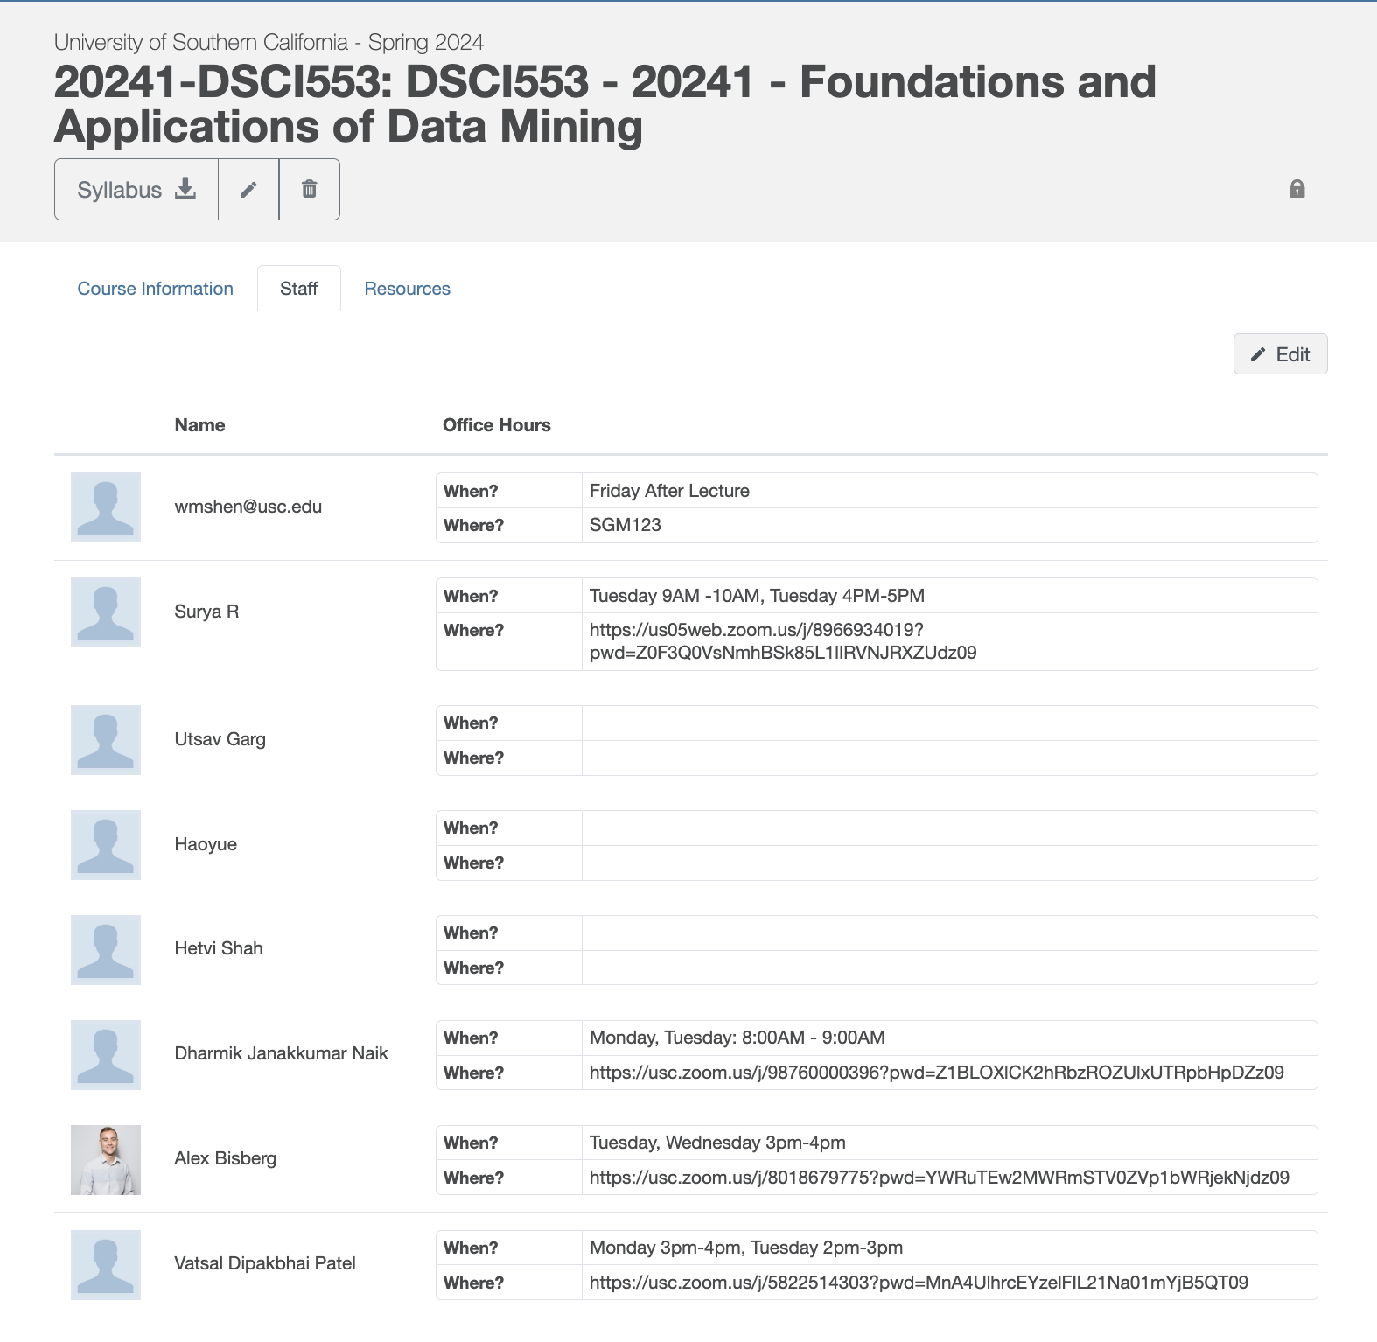
DSCI-553 Teaching Team

Slide 5
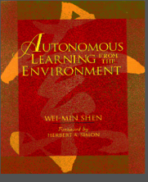

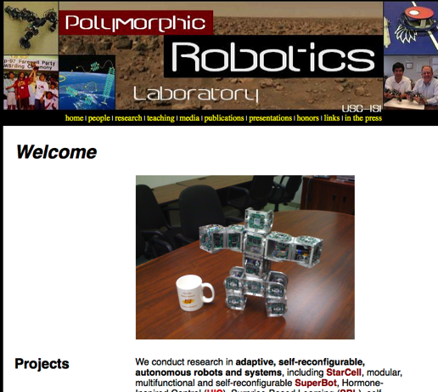
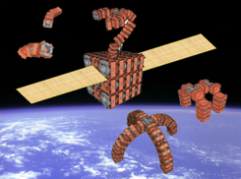
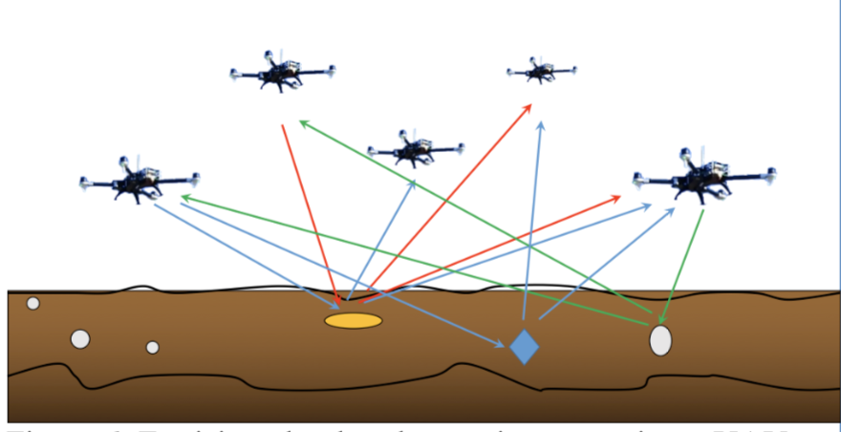
USC Polymorphic Robotics Lab
http://www.isi.edu/robots
Transformer Robots: Self-Reconfigurable & Modular
Surprise-Based Learning
Teaching
CS561 (AI)
CS360 (AI)
DSCI-552
DSCI-553

Slide 6
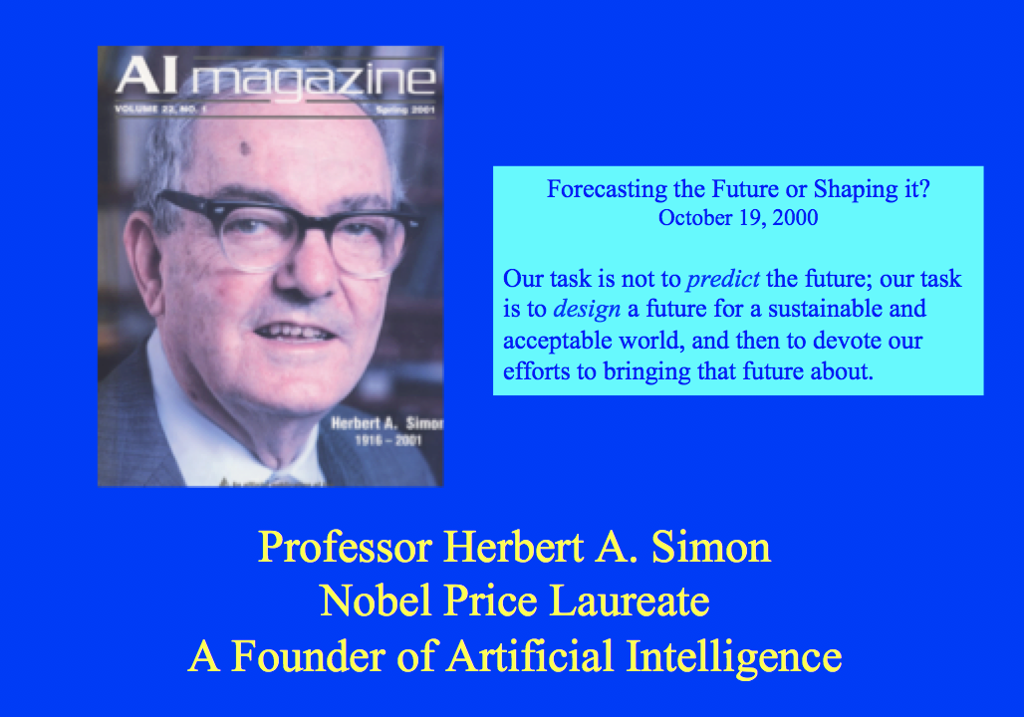
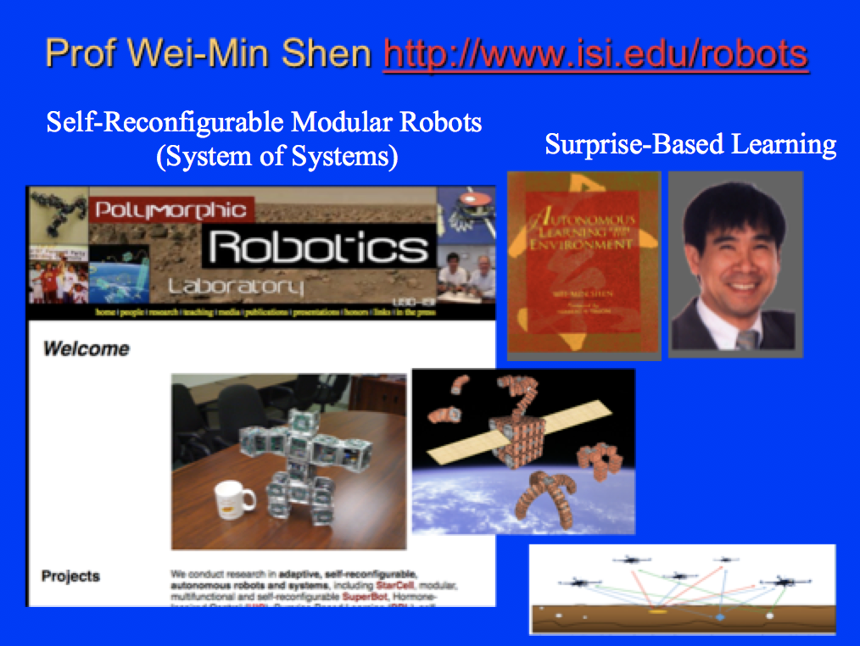
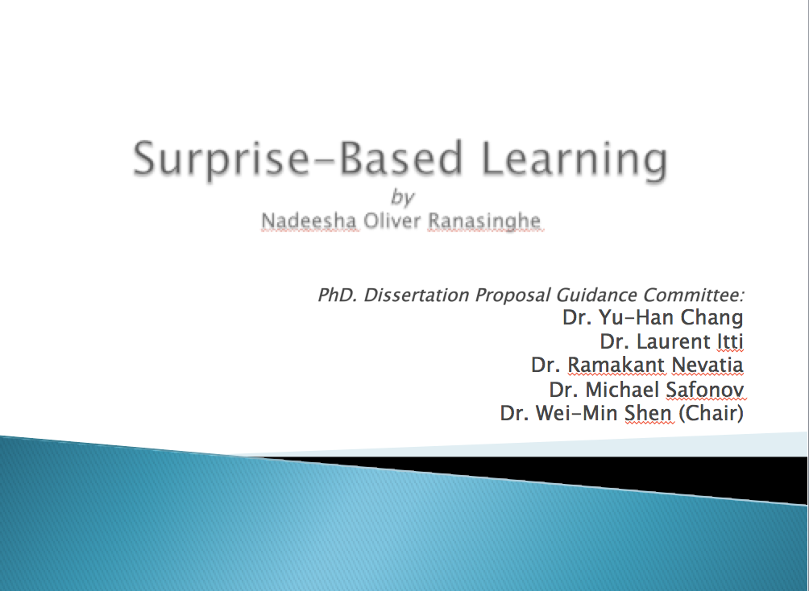
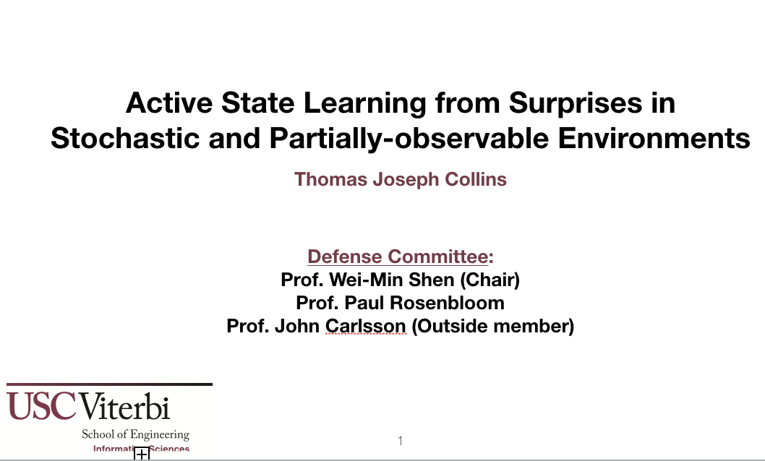
Surprise-Based Learning
Herbert A. Simon (1916-2001)
Nobel Prize Winner (AI, Machine Discovery)
Wei-Min Shen (1983 – present)
Autonomous Learning from the Environment
Nadeesha Ranasinghe (2005 – present)
Learn and predict unexpected changes
Thomas J. Collins (2013 – present)
Discovery of hidden/latent structures

Slide 7
My Research on Data Mining
DataCrystal for knowledge discovery from big data (NSF)
Discovery hidden variables from complex systems (DARPA)
Human Meridian Energy Sensing & Harmonization (USC+)
Digital hormone for distributed device coordination (NASA)
Biological Morphogenesis and digital hormones (Patents)
Human health as a distributed, complex, intelligent system
Editorial Board Member, Handbook of Data Mining and Knowledge Discovery, Oxford University Press, 2001
NSF Panel Member on Data Mining
One of the early starters of KDD at AAAI 1992

Slide 8
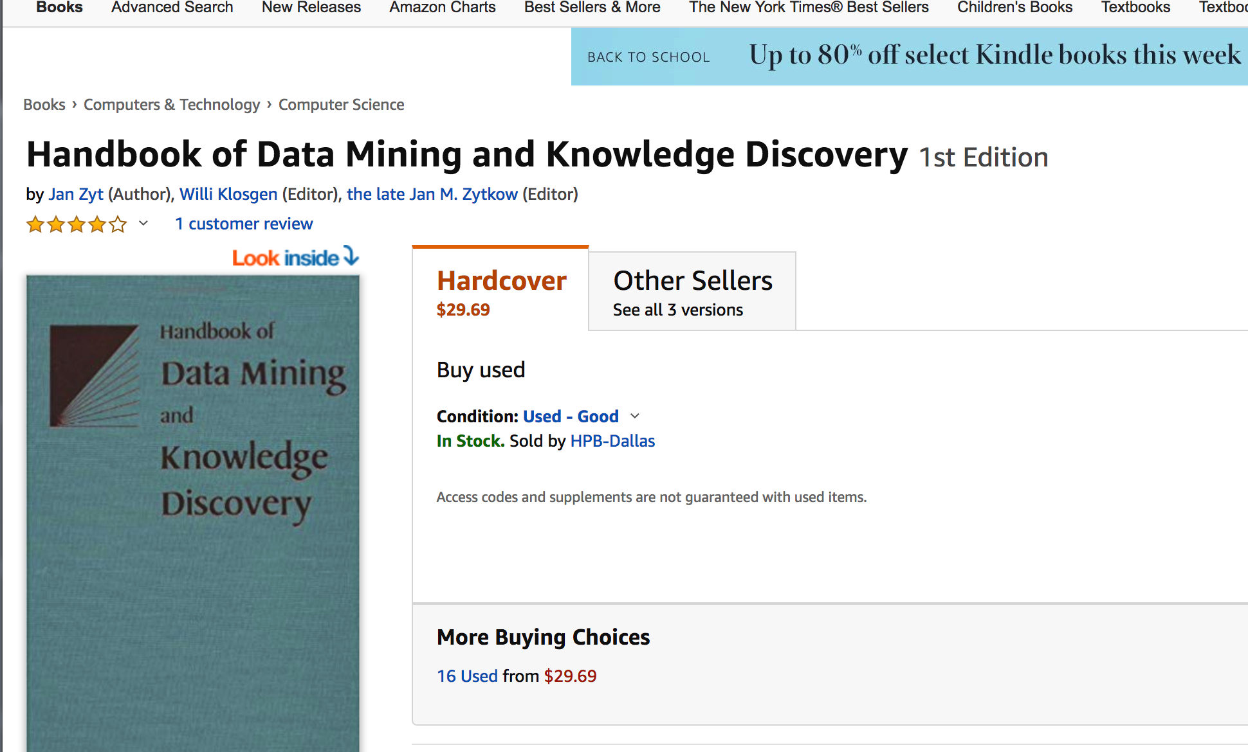
My Research on Data Mining

Slide 9
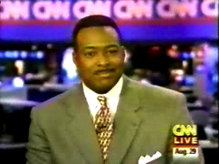
1997 RoboCup World Champion (CNN) (USC Dreamteam)
Notes:
USC Team first world Champions in robot soccer. Challenge to beat human champions by 2050. Video of first Sony Aibo

Slide 10

1997 RoboCup World Champion (CNN) (USC Dreamteam)
Notes:
USC Team first world Champions in robot soccer. Challenge to beat human champions by 2050. Video of first Sony Aibo

Slide 11
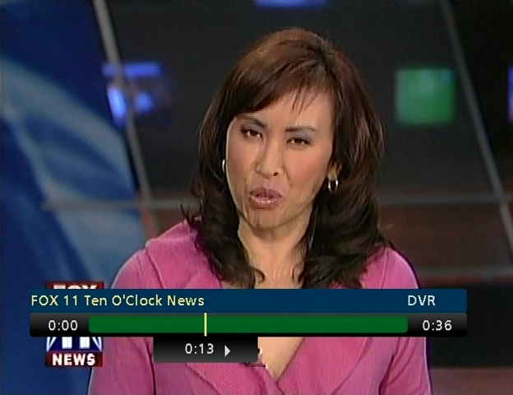
Introduction to SuperBot

Slide 12
Introduction to SuperBot

Slide 13
Please introduce yourself !

Slide 14
What is Data Mining? About THIS Course

Slide 15
What is Data Mining? Knowledge Discovery from Data

Slide 16
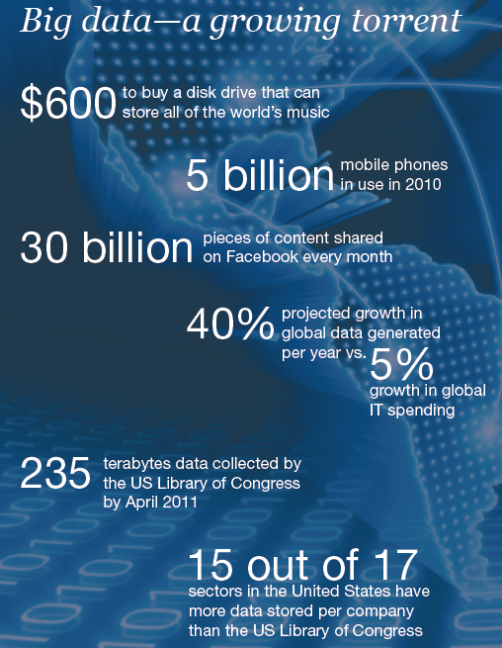
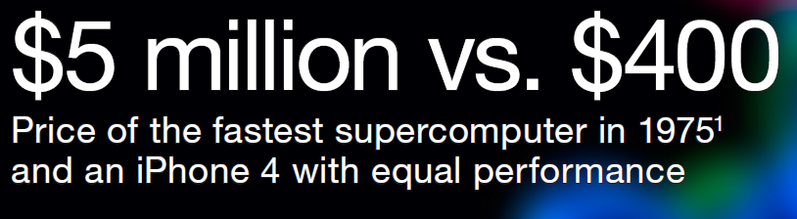

Slide 17
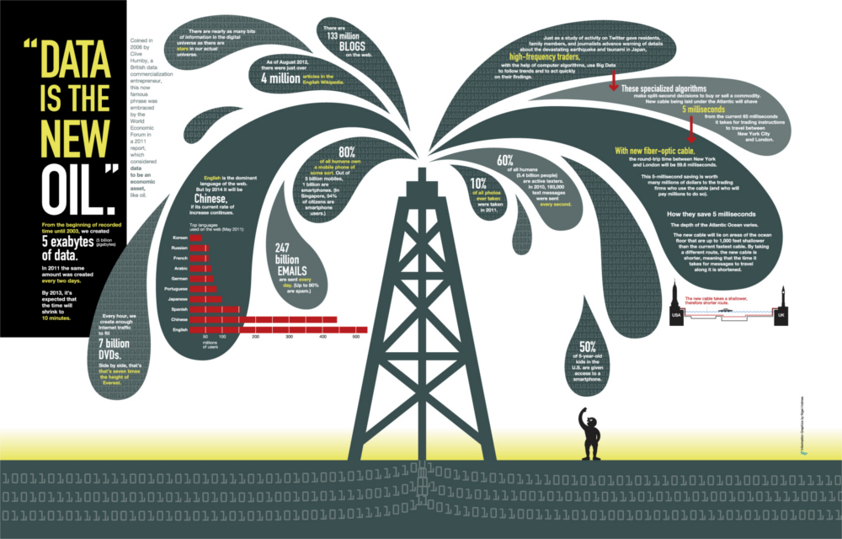

Data contains value and knowledge

Slide 18
Data Mining
But to extract the knowledge, data needs to be
Stored
Managed
And ANALYZED <= this class
Data Mining ≈ Big Data ≈ Predictive Analytics ≈ Data Science
Big Data Lifecycle

Slide 19
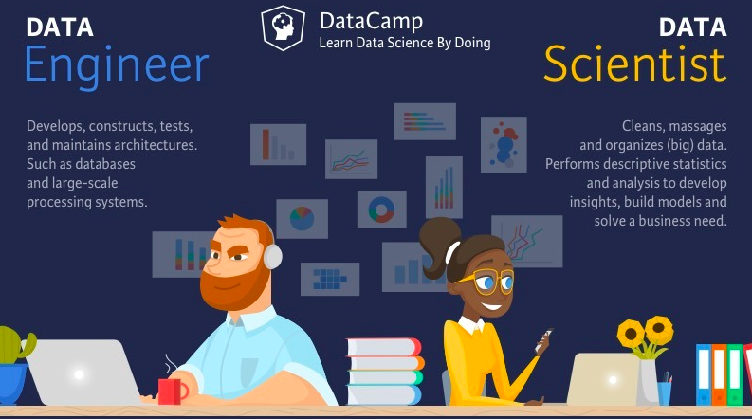

Slide 20
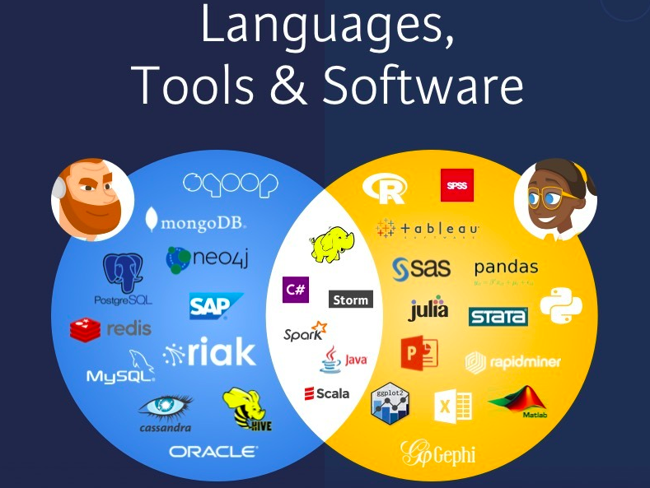

Slide 21
The Challenges of Big Data?
Cannot store in one place
Must be distributed
Failures for access may be unexpected
Unpredictable diversity
Messy, noisy, and errors are inevitable
Dynamic
……

Slide 22
What is Data Mining?
Given lots of data
Discover patterns and models that are:
Valid: hold on new data with some certainty
Useful: should be possible to act on the item
Unexpected: non-obvious to the system
Understandable: humans should be able to interpret the pattern

Slide 23
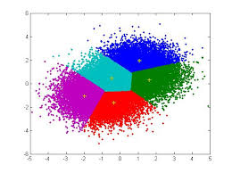
Data Mining Tasks
Descriptive methods
Find human-interpretable patterns that describe the data
Example: Clustering
Predictive methods
Use some variables to predict unknown or future values of other variables
Example: Recommender systems

Slide 24
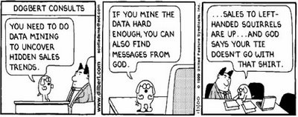
Meaningfulness of Analytic Answers
A risk with “Data mining” is that an analyst can “discover” patterns that are meaningless
Bonferroni’s principle:
If you look in more places for interesting patterns than your amount of data will support, you are bound to find some “craps”!

Slide 25
Meaningfulness of Analytic Answers
Example:
We want to find (unrelated) people who at least twice have stayed at the same hotel on the same day
10⁹ people being tracked – 1 billion
1,000 days ~ 3 years
Each person stays in a hotel 1% of time (1 day out of 100)
Hotels hold 100 people (so 10⁵ hotels)
enough to hold the 1% of a billion people who visit a hotel on any given day
If everyone behaves randomly will the data mining detect anything suspicious?

Slide 26
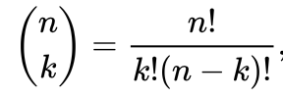
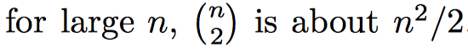
Meaningfulness of Analytic Answers (Cont’d)
10⁹ people, 1,000 days, 1% hotel stay, 10⁵ hotels
The probability of any two people both deciding to visit a hotel on any given day is 0.0001 (i.e., 1%*1%)
The chance that they will visit the same hotel for one day is
0.0001 /10⁵ = 10⁻⁹ ; for two given days = 10⁻¹⁸
The number of pairs of people is C(10⁹, 2) = 5 x 10¹⁷
The number of pairs of days is C(10³, 2) = 5 x 10⁵
Expected number of “suspicious” pairs of people:
5 x 10¹⁷ x 5 x 10⁵ x 10⁻¹⁸ = 250,000 (Wow! )
… too many combinations to check – we need to have some additional evidence to find “suspicious” pairs of people in some more efficient way

Slide 27
What matters when dealing with data?
Challenges
Usage
Quality
Context
Streaming
Scalability
Collect
Prepare
Ontologies
Text
Signals
Data
Modalities
Networks
Represent
Structured
Multimedia
Model
Reason
Visualize
Data Operators

Slide 28
Data Mining: Cultures
Data mining overlaps with:
Databases: Large-scale data, simple(r) queries
Machine learning: Small data, Complex models
CS Theory: Algorithms
Different cultures:
To a DB person, data mining is an extreme form of analytic processing – queries that examine large amounts of data
Result is the query answer
To a ML person, data-mining is the inference of models
Result is the parameters of the model
In this class we will do both!
CS Theory
Machine Learning
Data Mining
Database systems

Slide 29
About THIS Course

Slide 30
This Course
This course overlaps with machine learning, statistics, artificial intelligence, databases but more stress on
Scalability (big data)
Algorithms
Computing Architectures
Automatic & Efficient Handling of large data
Statistics
Machine
Learning
Data Mining
Database systems

Slide 31
What will we learn?
We will learn to mine different types of data:
Data are high dimensional
Data are graphs
Data are infinite/never-ending
Data are labeled
We will learn to use different models of computation:
MapReduce
Streams and online algorithms
Single machine in-memory

Slide 32
What will we learn?
We will learn to solve real-world problems:
Recommender systems
Market Basket Analysis
Spam detection
Duplicate document detection
We will learn various “tools”:
Linear algebra (Recomm. Sys., Communities)
Optimization (stochastic gradient descent)
Dynamic programming (frequent itemsets)
Hashing (LSH, Bloom filters)

Slide 33
How It All Fits Together
High dim. data
Graph data
Infinite data
Machine learning
Apps
Locality sensitive hashing
PageRank, SimRank
Filtering data streams
SVM
Recommender systems
Clustering
Community Detection
Web advertising
Decision Trees
Association Rules
Dimensionality reduction
Spam Detection
Queries on streams
Perceptron, kNN
Duplicate document detection

Slide 34
Course Logistics
Website: courses.uscden.net/d2l/
Lecture Notes and Video Records on DEN:
Post on the same day of the lecture
Quizzes, Homework, Exam, Competition
Readings
Mining of Massive Datasets
J. Leskovec, A. Rajaraman and J. Ullman
Free online: http://www.mmds.org
Other relevant papers

Slide 35
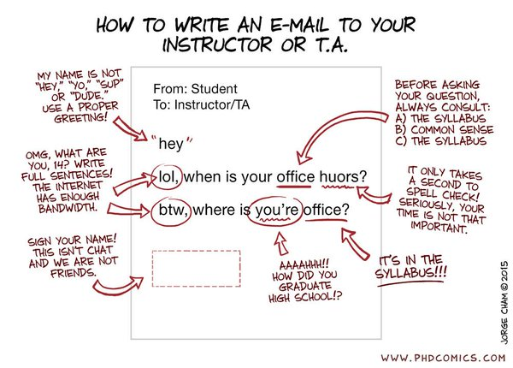
Logistics: Communication
Discussion board on Piazza (Blackboard)
Please enroll yourself, and you are all invited on Piazza
Questions and public communication with the course staff
Help your fellow students by contributing answers What a friend is for!
a post on the discussion board

Slide 36
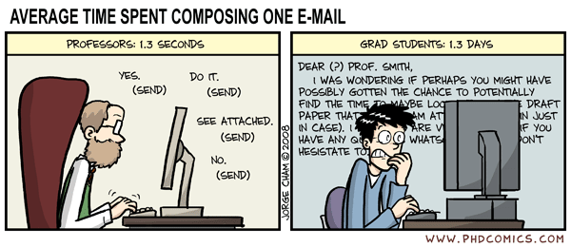
Logistics: Communication
We will post course announcements to
Piazza and DEN/Blackboard (please check regularly)
Emails:
Do not use emails unless it’s personal!

Slide 37
Work for the Course
Six homework: 42%
Programming assignments on Vocareum.com
MapReduce (2 weeks)
Frequent Itemsets (2 weeks)
Recommendation Systems (3 weeks***)
Detecting Communities in a Social Network (2 weeks)
Streaming data analysis (1 week)
Clustering big datasets (1 week)
Assignments take lots of time. Start early!!
One Grand Competition Project: 8% + bonus
Recommendation Systems
Please work on your own code! (very smart detective agents we have)

Slide 38
Work for the Course
Homework policy:
On Vocareum.com
You can test and submit your code
Your work will be auto-graded by scripts
Be careful to use the exact formats!
Late Penalty: One week late penalty: –20%,
0 points after one week
Your submitted code will be auto-checked by an advanced detective agent for similarities against all other submissions in the class
50% deduction if your submitted code has >75% similarity matches with some other submissions.
Free five-day extensions
Use the extension days on homework however you want
Submit your request for using free-extensions before deadline
No more extension days will be given for any other reasons

Slide 39
Work for the Course
Final Project and Grand Competition
We will be building a recommendation system based on homework-3
You will continue improving your recommendation system (homework-3) throughout the course
Your recommendation system will compete with systems from all other students in the class
Why are we doing the competition?

Slide 40

Work for the Course
Why are we doing the competition?
Learn how to handle real (big) datasets, e.g.,
http://grouplens.org/datasets/movielens/
You will have the opportunity to put something like this on your resume:
First Place, USC Data Mining Competition (202x)
I will have something to say if you want me to be your reference ☺

Slide 41
Previous Winners (2023 Fall)
USC Data Mining Competition (2023F)
1. Aoyan Liang
2. Tingyu Yang
3. Utsav Garg
4. Alvin Huang
5. Xiaoyu Dong
6. Xiaoyan Zhang

Slide 42
Previous Winners (2023 Spring)
USC Data Mining Competition (2023-spring)
1. Yiyang Liu
2. Karthik Peddi
3. Changxun (Shawn) Li
4. Vrinda Shroff
5. Yi Ming
6. Junye Li

Slide 43
Previous Winners (2022 Fall)
USC Data Mining Competition (2022F)
1. Zhang Zhiyu
2. Li Chaoyu, Wang Yunhe
3. Tamazian Alain, Minoofar Amir, Siddhart Ganesh
4. Tian Jiayu
5. Ankit Nitin Kumar Shah
6. Lin Chih-Hsien

Slide 44
Previous Winners (2022 Spring)
USC Data Mining Competition (2022S)
Feichi Yang *
Shaswat Anand (your TA)
Jheel Ketan Patel (your TA)
Srinag Vinil Tummala
Shayan Javid Yazdi
Viraj Mehta (your TA)

Slide 45
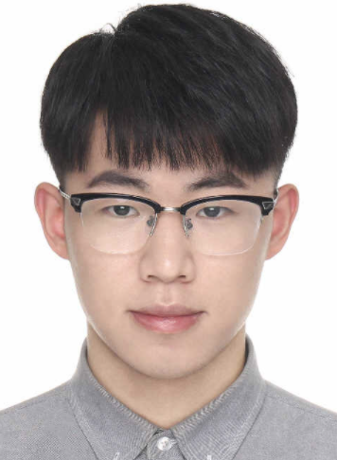
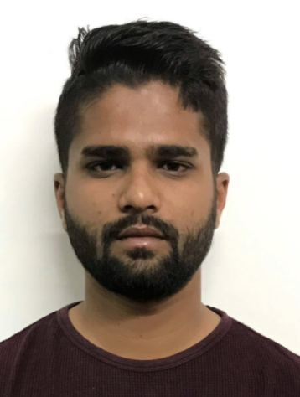
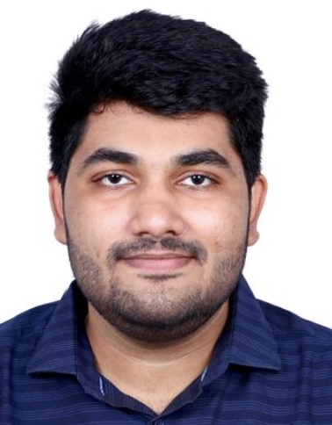
Previous Winners (2021 Fall)
USC Data Mining Competition
Li WenXuan (your TA)
Daniel Hao
Tirth Patel (your TA)
Dhruvil Anil Trivedi
Vishal Ajaybhai Kapadia (your TA)
Deep Prakash Amin

Slide 46
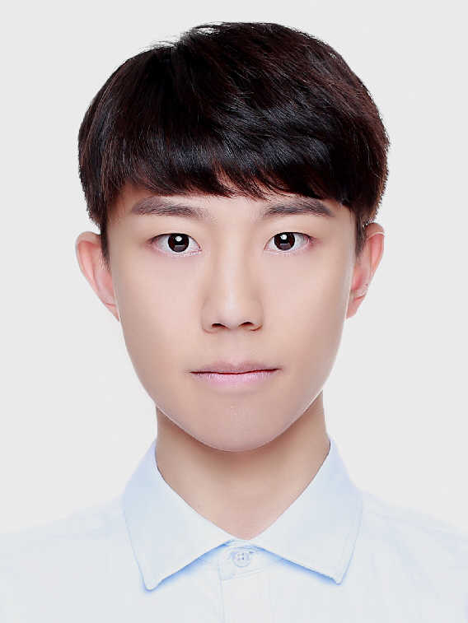
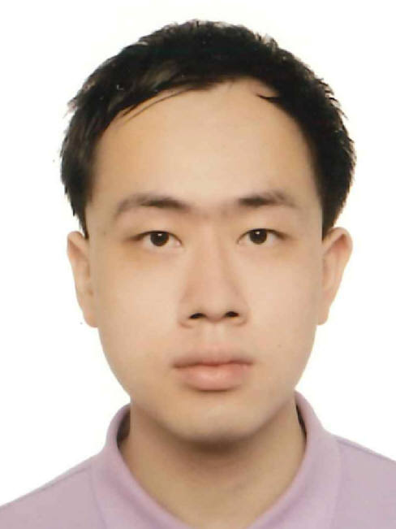

Previous Winners (2021 Spring)
USC Data Mining Competition
Zeyang Gong (0.9721) (your TA)
Jiemin Tang (0.9744)
Nitin Chandra Perumandl (0.9745)
Shiyang Chen (0.9749)
Matheus Schmitz (0.9750)
Yuxin Jiang (0.9752)

Slide 47
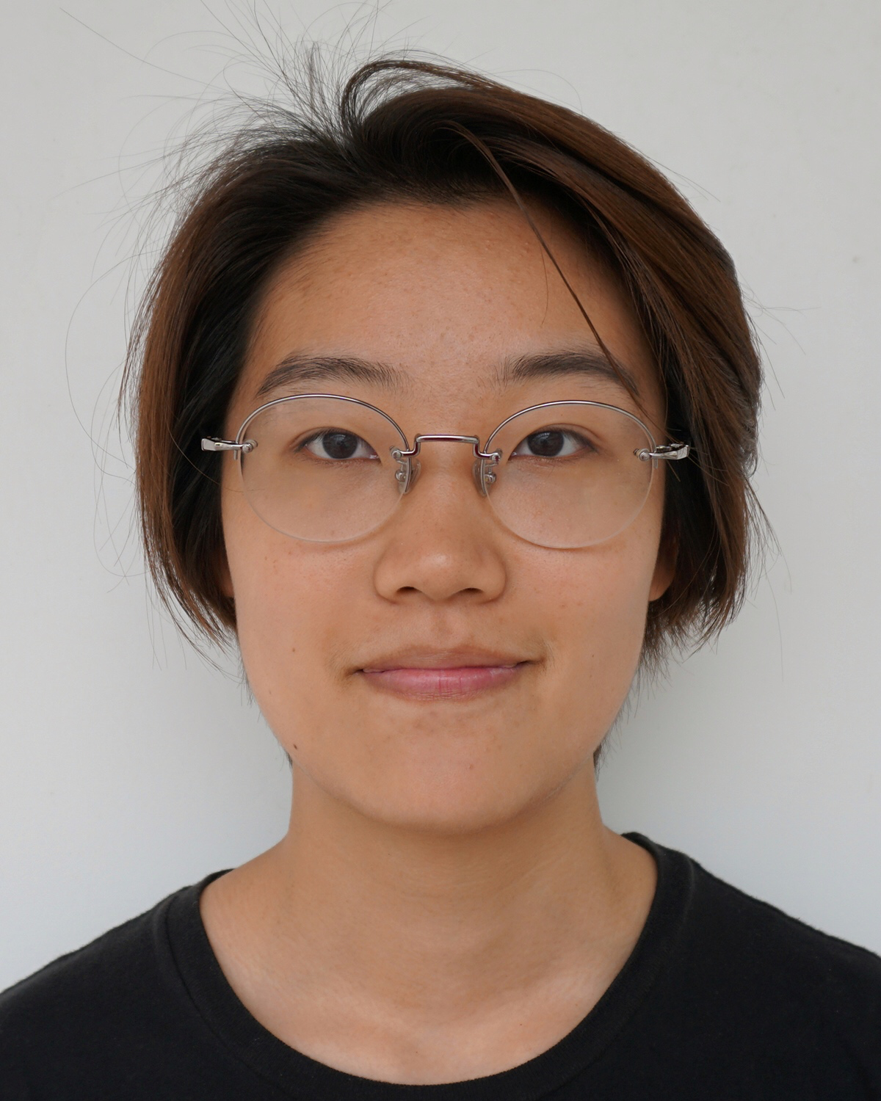
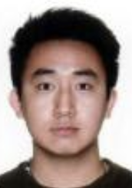
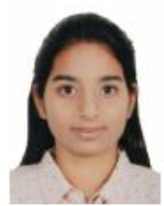
Previous Winners (2019)
USC Data Mining Competition
First Place, Yang Zheng
Second Place, Peilun Yan
Third Place, Nivedetha Kumaram

Slide 48

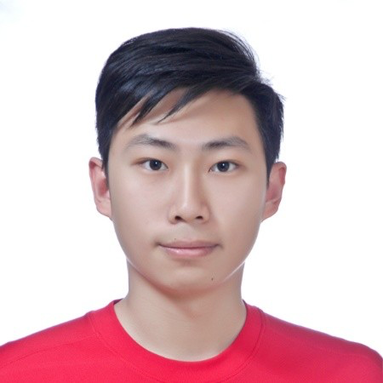
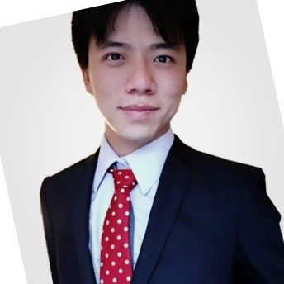
Previous Winners (2018)
USC Data Mining Competition
First Place, Hongtao Yang
Second Place, Chen Lou
Third Place, Bufan Zeng

Slide 49
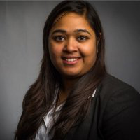
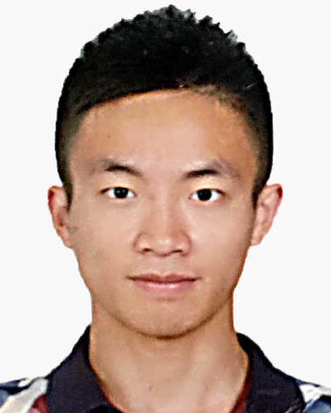
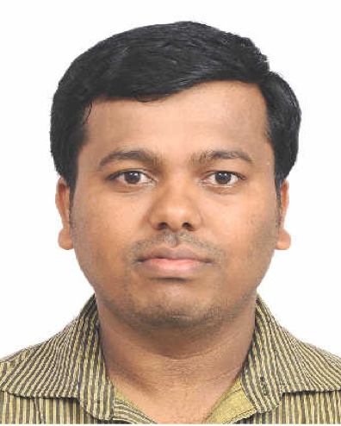
Previous Winners (2017)
USC Data Mining Competition
First Place, Priyambada Jain
Second Place, Zihao Zhai
Third Place, Vijayakumar Gedigeri

Slide 50
Work for the Course
Not-So-Short weekly quizzes: 30%
Not-So-Short in-class quizzes every week
Covers the material learned in the previous week
You may drop two of your lowest quizzes
Comprehensive exam: 20%
Tentative Date: Week16 class time
The exam will cover everything taught in class
No final exam but the final project will due online at the scheduled final date / time
It’s going to be fun and hard work.

Slide 51
Quiz and Lecture (where and when)
2:00-2:20 PM (in Class/DEN)
In class, please bring your laptop computers
DEN: join lecture Webex and turn on your camera as instructed
Must use Lockdown Browser and Password
2:30 – 5:20PM (lectures in Class/DEN)
Notes
2nd Week: Practice Quiz-0 on DEN (pswd=”welcome”)
3nd Week: start the real quizzes

Slide 52
Prerequisites (Hard)
Algorithms
Dynamic programming, basic data structures, ….
Basic probability
Moments, typical distributions, MLE, …
Programming
Python will be required
Spark and/or Scala (for homework)
We provide some background, but the class will be fast paced

Slide 53
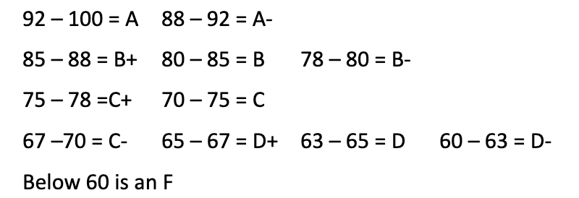
Course Grade

Slide 54
What’s After the Class?
Directed Research
Course producer or grader positions
Paid TA positions
Paid RA positions (maybe)

Slide 55
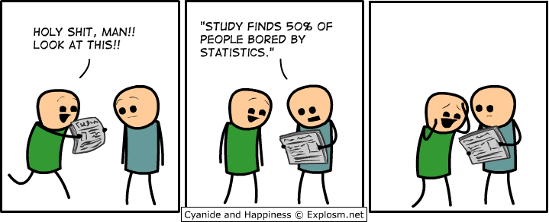
To-do items
Download the textbook
Install Spark on your machine (http://spark.apache.org/)
Get familiar with Vocareum and how to use the terminal window
Play with datasets http://grouplens.org/datasets/movielens/ and http://jmcauley.ucsd.edu/data/amazon/links.html

Slide 56

Schedule around Holidays
If a lecture day falls on a holiday
Please watch the lectures video on DEN
Please study the slides and zoom videos yourself
Quizzes will start on the 3rd week (2nd week practice)
Join 15min before, quiz on time for 20 min. lectures after
Please arrange your camera as this

Slide 57

About Auditing …
Auditing the class is fine if we have space
Please email me if you want to audit the class
Check with your advisor for the last day to drop a class without a mark of “W”

Slide 58
Some Backup Slides

Slide 59
My Other Research Topics
Biological morphogenesis
Self-organizing swarm robots and UAVs
Self-healing (scalable) systems
Underwater robotic swarm
Self-assembly in space
Oil and energy robotics
Self-configurable networks
Distributed Power/Resource Sharing
Evolution of brains
Surprise-Based Learning (SBL) discovering hidden variables

Slide 60

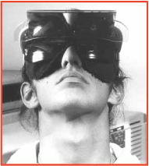

Why Surprise-Based Learning?
New Environment/Task -> Learning -> Knowledge/Skill
Key Idea: Detect and learn from “surprises”
Adaptive to new environments (no priori knowledge, “swim”)
Learn to accomplish new tasks (goals may change dynamically)
Self-heal unexpected failures or dynamics (e.g., inverted visions)
Know-how -> Surprises -> Learn -> Recovery
Human health as a complex system to be discovered

Slide 61
Machine Learning and Discovery
Supervised Learning
Unsupervised Learning
Type I: Clustering the data
Automatically group the data into clusters
Type II: Parameter Learning (states are known)
Learn transitions, sensor models, & current state
Type III: Structural & non-parametric Learning
States have internal structures (not just “symbols”)
States are not known and must be learned
Machine Discovery

Slide 62
SBL Objectives
Autonomously extracts the states and corresponding state machines from the interactive experience with the environment
Number of states, observed features of states & transitions between states are not necessarily known or predetermined
Top-down approach to meet low-level sensor measurements and evidences
Learn the structure of states for description while detecting, explaining and learning from surprises in the experience
“Surprise” connects to “anomaly” and “unexpected interference”
End-to-end Learning
Life-long Learning
Incremental and online learning

Slide 63
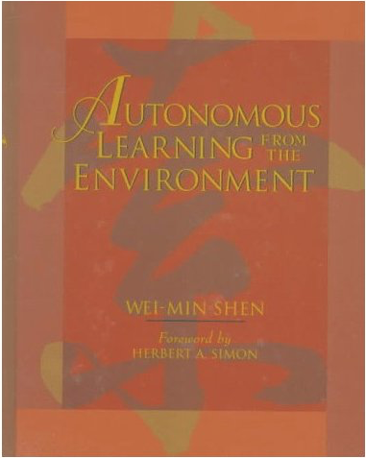
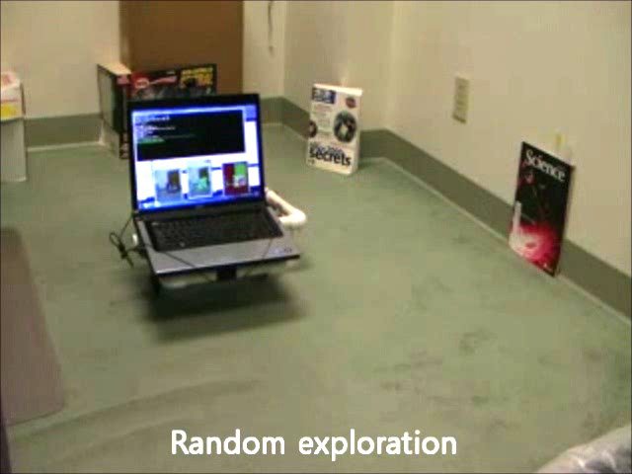
Surprise-Based Learning (Structure)
Perception
observation
Surprise
Analyzer
prediction
Predictor
TASK/ENVIRONMENT
(BLACK BOX)
Model Modifier
Model Synchronizer
Model
actions
Plan
Action Selector
(Planner)
Goals (Intensions)
The Learner continuously makes predictions, detects surprise, analyzes surprises, extracts critical information from surprises, and improves and use its action models to achieve goals
Surprise ==> Model ==> Prediction

Slide 64
Surprise Types and Key Problems
Types of surprise
Unexpected failures
Unexpected successes
Null prediction surprise
When there is no a priori model
Differentiate “new information” from noise
Focus attention on the relevant features
Seek differences that are statistically significant

